Slide 1
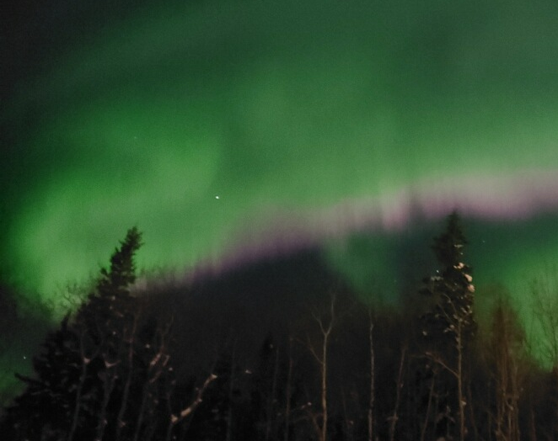
Plasma and the Alfvén Wave from Magnetohydrodynamics
Hunter Barndt
University of Alaska Fairbanks

Slide 2
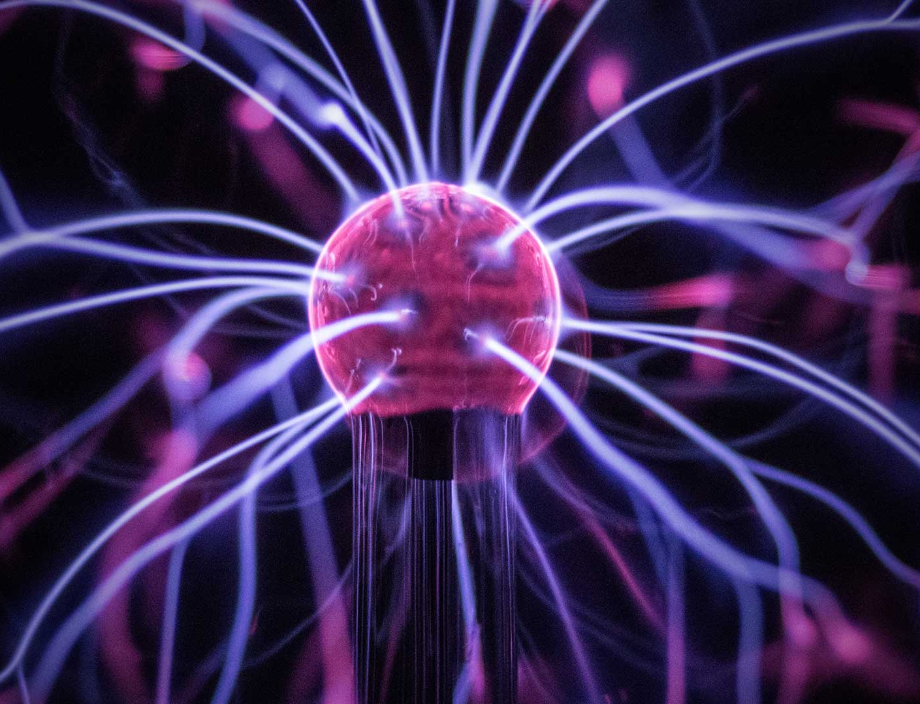
What is Plasma?
Fourth state of matter
In essence, it consists of ionized gas and free electrons.
Comprises 99% of all visible matter in the universe
Notes:
Usually caused by heating up gas even more

Slide 3
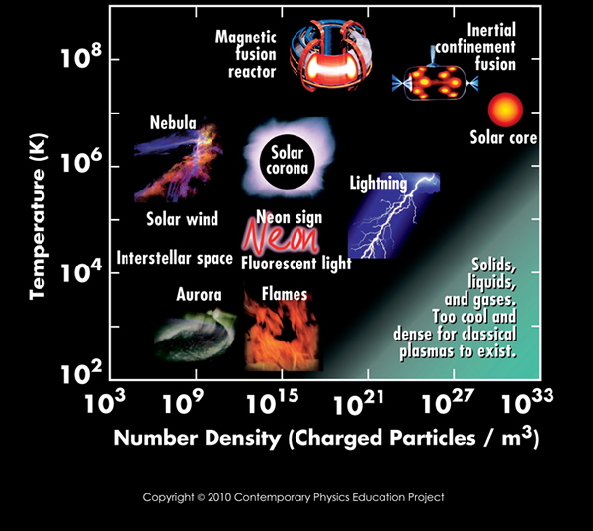
Plasmas in Action:
Plasmas come in many shapes and sizes.
These different types of plasmas are described using the density of the charged particles and the temperature of the plasma

Slide 4
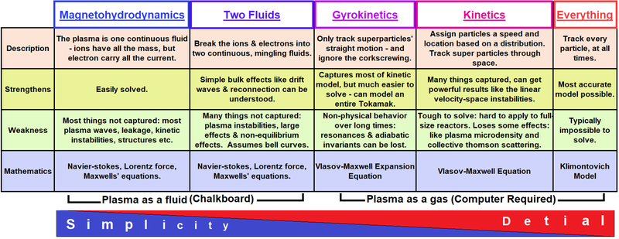
Models of Plasma
Each model has its own uses depending on the problem or application at hand.

Slide 5
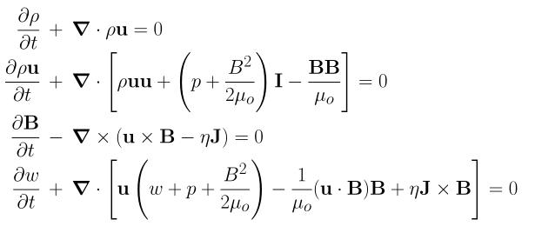
Magnetohydrodynamics (MHD)
Described using the Navier-Stokes Equations coupled with Maxwell’s Equations.
Mass Continuity:
Momentum Continuity:
Magnetic Field Continuity:
Energy Continuity:

Slide 6

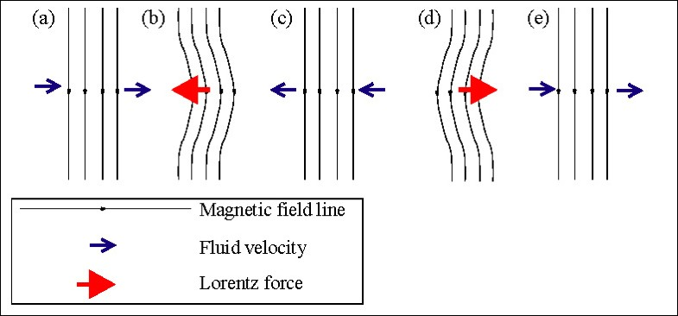
What is this Alfvén Wave?
One of the fundamental wave modes of the MHD model of plasma.
Characterized by ions in the plasma oscillating in response to the restoring force provided by the effective tension of the magnetic field lines.
Travels parallel to the magnetic field.

Slide 7
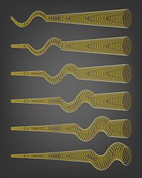
The Discovery
In the early 1900s it was unclear why the solar corona surrounding the sun was much hotter than the surface (1 million vs a few thousand Kelvin).
In 1942, Hannes Alfvén proposed the existence of so called electromagnetic-hydrodynamic waves that carry energy from the surface to the corona and the solar wind.
These, of course, turned out to be the Alfvén waves.
These Alfvén waves are an important mechanism by which energy is transported in MHD systems.
Example: These are Alfvén S-waves. They flow from the base of black hole jets.
Notes:
Intuitively, you would think otherwise.

Slide 8
My Project:
To create a 1-D simulation of the Alfvén wave using the MHD equations.
Boundary Conditions:
Cold Plasma:
Pressure is equal zero
Not using the energy continuity equation

Slide 9
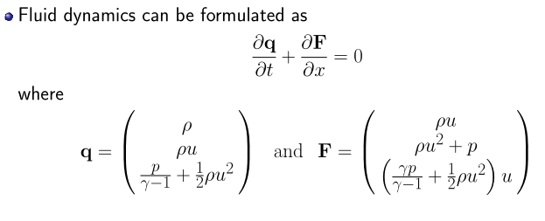
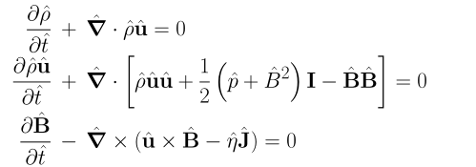
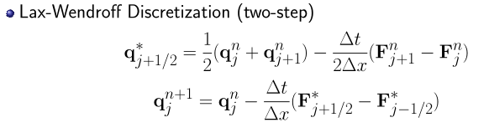

1-D MHD Simulation:
Normalized set of MHD Equations:
Numerical Method:
Changing the Magnetic Field Equation using vector identities:
Notes:
Note, even in 1-D you still need to keep track of the other dimensions

Slide 10
References:
Plasma Types Graph: https://lasers.llnl.gov/science/understanding-the-universe/plasma-physics
Plasma Modeling Graph: https://en.wikipedia.org/wiki/Plasma_modeling
MHD – Equations: Dr. Delamere Lecture Notes
Alfven Wave: https://link.springer.com/referenceworkentry/10.1007%2F978-1-4020-4423-6_3
Alfven S-Waves: https://en.wikipedia.org/wiki/Alfvén_wave#Experimental_studies_and_observations

